Slide 1
Graphic Design Basics
07

Slide 2
Summary
Graphic Design Basics
Proximity
Alignment
Repetition
Contrast
Whitespace
Color
Typography

Slide 3

Why Graphic Design?
Engineers are not designers
And it shows…

Slide 4

Why Graphic Design?
Designers aren’t engineers
That shows as well…
Notes:
Muito artsy, mas usabilidade patética

Slide 5


But Design is important!
Notes:
Ajuda a vender as nossas ideias e projectos!

Slide 6
Why Graphic Design Basics?
We won’t be creating any designers here…
… but let’s try to at least look good!

Slide 7
Universal Principles
Applicable to different media
Magazines
Books
Leaflets
Business cards
…

Slide 8
Universal Principles
But also…
Web pages
User Interfaces
Project Reports
Project Presentations
Video

Slide 9
Proximity
01

Slide 10
Proximity
Basic Idea:
Related items should be close to each other

Slide 11
Does something seem different?

Slide 12
What about now?
Notes:
Não mudou nada! Só a proximidade!

Slide 13
What about now?
Notes:
Não mudou nada! Só a proximidade!

Slide 14
And now? Something noteworthy?
Notes:
Não mudou nada! Só a proximidade!

Slide 15
And now? Something noteworthy?
Notes:
Não mudou nada! Só a proximidade!

Slide 16
How many info elements on the card?
Manuel da Silva, Engenheiro
1000 - Lisboa, Portugal
Consultora, Lda.
Rua das Casas, 9
212123456

Slide 17
How many info elements on the card?
Manuel da Silva, Engenheiro
1000 - Lisboa, Portugal
Consultora, Lda.
Rua das Casas, 9
212123456

Slide 18
How do I read it? Like this?
Manuel da Silva, Engenheiro
1000 - Lisboa, Portugal
Consultora, Lda.
Rua das Casas, 9
212123456

Slide 19
Or like this?
Manuel da Silva, Engenheiro
1000 - Lisboa, Portugal
Consultora, Lda.
Rua das Casas, 9
212123456

Slide 20
Grouping simplifies it!
Consultora, Lda.
Manuel da Silva,
Engenheiro
Rua das Casas Novas, 9
1000 - Lisboa, Portugal
212123456

Slide 21
Two elements!
Consultora, Lda.
Manuel da Silva,
Engenheiro
Rua das Casas Novas, 9
1000 - Lisboa, Portugal
212123456

Slide 22
No problems reading it
Consultora, Lda.
Manuel da Silva,
Engenheiro
Rua das Casas Novas, 9
1000 - Lisboa, Portugal
212123456

Slide 23

How many movies will be shown?
Ciclo de Cinema Raro
Sábado 13 de Maio, Dia do Documentário, A Importância do Sol, de Afonso Luis, O Destino do Livro, Manuel Manueles, Segunda dia 14 de Maio, Dia do Filme Numerado, O Barco 123, Teresa Silva, 432 Pessoas, Manuel “Contador” Pereira, 12 Línguas em 12 Livros, Paulo Armando, Bilhetes a €10, informações pelo 212345678, Cinema da Esquina, Cine-Teatro
Notes:
E quantas categorias?

Slide 24
How many movies will be shown?
Ciclo de Cinema Raro
Dia do Documentário
Sábado 13 de Maio,
A Importância do Sol, Afonso Luis
O Destino do Livro, Manuel Manueles
Dia do Filme Numerado,
Segunda dia 14 de Maio,
O Barco 123, Teresa Silva
432 Pessoas, Manuel “Contador” Pereira,
12 Línguas em 12 Livros, Paulo Armando,
Cinema da Esquina
Cine-Teatro
Bilhetes a €10,
Informações pelo 212345678

Slide 25
Four Groups
Ciclo de Cinema Raro
Dia do Documentário
Sábado 13 de Maio,
A Importância do Sol, Afonso Luis
O Destino do Livro, Manuel Manueles
Dia do Filme Numerado,
Segunda dia 14 de Maio,
O Barco 123, Teresa Silva
432 Pessoas, Manuel “Contador” Pereira,
12 Línguas em 12 Livros, Paulo Armando,
Cinema da Esquina,
Cine-Teatro
Bilhetes a €10,
Informações pelo 212345678

Slide 26
Highlight more important information
Ciclo de Cinema Raro
Dia do Documentário
Sábado 13 de Maio,
A Importância do Sol, Afonso Luis
O Destino do Livro, Manuel Manueles
Dia do Filme Numerado,
Segunda dia 14 de Maio,
O Barco 123, Teresa Silva
432 Pessoas, Manuel “Contador” Pereira,
12 Línguas em 12 Livros, Paulo Armando,
Cinema da Esquina,
Cine-Teatro
Bilhetes a €10,
Informações pelo 212345678
Notes:
Menos importância ao acessório

Slide 27
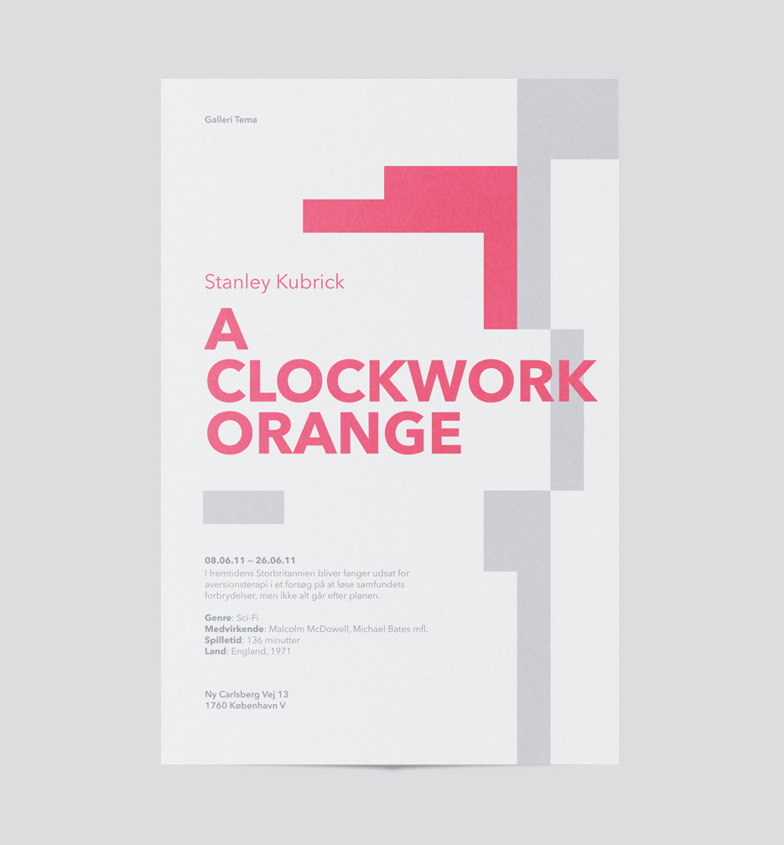
Proximity in Action

Slide 28
Information Hierarchies
Ficção Científica
The Skinner
Dune
Brass Man
Nightfall
Informática
Computer Graphics
Multimedia Information
Artificial Intelligence
Python Cookbook
Romance
White Teeth
The Impressionist
Viagens
Visita a Amsterdão
Conhecer Paris
Passeando por Milão

Slide 29
Information Hierarchies
Ficção Científica
The Skinner
Dune
Brass Man
Nightfall
Informática
Computer Graphics
Multimedia Information
Artificial Intelligence
Python Cookbook
Romance
White Teeth
The Impressionist
Viagens
Visita a Amsterdão
Conhecer Paris
Passeando por Milão

Slide 30
What has changed?
Ficção Científica
The Skinner
Dune
Brass Man
Nightfall
Informática
Computer Graphics
Multimedia Information
Artificial Intelligence
Python Cookbook
Romance
White Teeth
The Impressionist
Viagens
Visita a Amsterdão
Conhecer Paris
Passeando por Milão

Slide 31

Visual Hierarchies: which is right?

Slide 32
Visual Hierarchies: which is right?

Slide 33
Proximity – Summary
Group related elements
Makes reading easier
Highlight what is important
Information Hierarchy
Show some elements to be different

Slide 34
Alignment
02

Slide 35
Alignment
Nothing should be placed at random
A good alignment unifies and organizes the elements
Notes:
Unidade é um dos princípios básicos: gostamos mais de coisas que parecem “jogar bem” umas com as outras

Slide 36

We don’t like messy things…

Slide 37

We prefer order!
Notes:
A maneira mais fácil de produzir algo com mau aspecto é descurar o alinhamento

Slide 38
Take advantage of natural lines: margins
Produção de Conteúdos Multimédia
Relatório do Projecto
Daniel Gonçalves
Instituto Superior Técnico
Março de 2007

Slide 39
Take advantage of natural lines: margins
Produção de Conteúdos Multimédia
Relatório do Projecto
Daniel Gonçalves
Instituto Superior Técnico
Março de 2007

Slide 40
Take advantage of natural lines: margins
Produção de Conteúdos Multimédia
Relatório do Projecto
Daniel Gonçalves
Instituto Superior Técnico
Março de 2007

Slide 41
The problem with centering
It is not bad…
… but has little impact
STRONG alignments are better

Slide 42
Which one would we hire?
Consultora, Lda.
Manuel da Silva,
Engenheiro
Rua das Casas Novas, 9
1000 - Lisboa, Portugal
212123456

Slide 43
Which one would we hire?
Consultora, Lda.
Manuel da Silva, Engenheiro
Rua das Casas Novas, 9
1000 - Lisboa, Portugal
212123456

Slide 44
Natural lines – Other Elements
Manuel Silva
Obras completas
Uma colectânea das obras literárias do grande escritor lisboeta

Slide 45
Natural lines – Other Elements
Manuel Silva
Obras completas
Uma colectânea das obras literárias do grande escritor lisboeta
This is aligned to what???

Slide 46
Natural lines – Other Elements
Manuel Silva
Obras completas
Uma colectânea das obras literárias do grande escritor lisboeta

Slide 47
Natural lines – Other Elements
Manuel Silva
Obras completas
Uma colectânea das obras literárias do grande escritor lisboeta

Slide 48

Natural lines – Other Elements
Guia de Filmes Essenciais
de 2006
Rui Silva

Slide 49
Natural lines – Other Elements
Guia de Filmes Essenciais
de 2006
Rui Silva

Slide 50
Natural lines – Other Elements
Guia de Filmes Essenciais
de 2006
Rui Silva

Slide 51
Natural lines – Other Elements
Guia de Filmes Essenciais
de 2006
Rui Silva

Slide 52
Natural lines – Other Elements
Guia de Filmes Essenciais
de 2006
Rui Silva

Slide 53
Natural lines – Other Elements
Guia de Filmes Essenciais
de 2006
Rui Silva

Slide 54

Natural lines – Other Elements
Guia de Filmes Essenciais
de 2006
Rui Silva

Slide 55
Natural lines – Other Elements
Guia de Filmes Essenciais
de 2006
Rui Silva

Slide 56
Left and Right
PCM
Produção de Conteúdos Multimédia

Slide 57
Left and Right
PCM
PCM
Produção de Conteúdos Multimédia
Produção de Conteúdos Multimédia
PCM
Produção de Conteúdos Multimédia

Slide 58

Before…
Jornal de Produção de Conteúdos Multimédia
Março de 2007
The quick brown fox jumped over the lazy dog. The quick brown fox jumped over the lazy dog. The quick brown fox jumped over the lazy dog. The quick brown fox jumped over the lazy dog.
The quick brown fox jumped over the lazy dog. The quick brown fox jumped over the lazy dog. The quick brown fox jumped over the lazy dog. The quick brown fox jumped over the lazy dog. The quick brown fox jumped over the lazy dog. The quick brown fox jumped over the lazy dog.
The quick brown fox jumped over the lazy dog. The quick brown fox jumped over the lazy dog. The quick brown fox jumped over the lazy dog. The quick brown fox jumped over the lazy dog. The quick brown fox jumped over the lazy.
The quick brown fox jumped over the lazy dog. The quick brown fox jumped over the lazy dog. The quick brown fox jumped over the lazy dog. The quick brown fox jumped over the lazy dog. The quick brown fox jumped over the lazy dog. The quick brown fox jumped over the lazy dog. That goes away w
The quick brown fox jumped over the lazy dog. The quick brown fox jumped over the lazy dog. The quick brown fox jumped over the lazy dog. The quick brown fox jumped over the lazy dog. The quick brown fox jumped over the lazy dog.
The quick brown fox jumped over the lazy dog. The quick brown fox jumped over the lazy dog. The quick brown fox jumped over the lazy dog. The quick brown fox jumped over the lazy dog. The quick brown fox jumped over the lazy dog. The quick brown fox jumped over the lazy dog. The quick brown fox jumped over the lazy dog.
The quick brown fox jumped over the lazy dog. The quick brown fox jumped over the lazy dog. The quick brown fox jumped over the lazy dog. The quick brown fox jumped over the lazy dog.
PC
M
©2007 Corpo Docente de PCM

Slide 59

After…
Jornal de Produção de Conteúdos Multimédia
Março de 2007
The quick brown fox jumped over the lazy dog. The quick brown fox jumped over the lazy dog. The quick brown fox jumped over the lazy dog. The quick brown fox jumped over the lazy dog.
The quick brown fox jumped over the lazy dog. The quick brown fox jumped over the lazy dog. The quick brown fox jumped over the lazy dog. The quick brown fox jumped over the lazy dog. The quick brown fox jumped over the lazy dog. The quick brown fox jumped over the lazy dog.
The quick brown fox jumped over the lazy dog. The quick brown fox jumped over the lazy dog. The quick brown fox jumped over the lazy dog. The quick brown fox jumped over the lazy dog. The quick brown fox jumped over the lazy.
The quick brown fox jumped over the lazy dog. The quick brown fox jumped over the lazy dog. The quick brown fox jumped over the lazy dog. The quick brown fox jumped over the lazy dog. The quick brown fox jumped over the lazy dog. The quick brown fox jumped over the lazy dog. That goes away without
The quick brown fox jumped over the lazy dog. The quick brown fox jumped over the lazy dog. The quick brown fox jumped over the lazy dog. The quick brown fox jumped over the lazy dog. The quick brown fox jumped over the lazy dog.
The quick brown fox jumped over the lazy dog. The quick brown fox jumped over the lazy dog. The quick brown fox jumped over the lazy dog. The quick brown fox jumped over the lazy dog. The quick brown fox jumped over the lazy dog. The quick brown fox jumped over the lazy dog. The quick brown fox jumped over the lazy dog.
The quick brown fox jumped over the lazy dog. The quick brown fox jumped over the lazy dog. The quick brown fox jumped over the lazy dog. The quick brown fox jumped over the lazy dog.
PC
M
©2007 Corpo Docente de PCM

Slide 60
After…
Jornal de Produção de Conteúdos Multimédia
Março de 2007
The quick brown fox jumped over the lazy dog. The quick brown fox jumped over the lazy dog. The quick brown fox jumped over the lazy dog. The quick brown fox jumped over the lazy dog.
The quick brown fox jumped over the lazy dog. The quick brown fox jumped over the lazy dog. The quick brown fox jumped over the lazy dog. The quick brown fox jumped over the lazy dog. The quick brown fox jumped over the lazy dog. The quick brown fox jumped over the lazy dog.
The quick brown fox jumped over the lazy dog. The quick brown fox jumped over the lazy dog. The quick brown fox jumped over the lazy dog. The quick brown fox jumped over the lazy dog. The quick brown fox jumped over the lazy.
The quick brown fox jumped over the lazy dog. The quick brown fox jumped over the lazy dog. The quick brown fox jumped over the lazy dog. The quick brown fox jumped over the lazy dog. The quick brown fox jumped over the lazy dog. The quick brown fox jumped over the lazy dog. That goes away without
The quick brown fox jumped over the lazy dog. The quick brown fox jumped over the lazy dog. The quick brown fox jumped over the lazy dog. The quick brown fox jumped over the lazy dog. The quick brown fox jumped over the lazy dog.
The quick brown fox jumped over the lazy dog. The quick brown fox jumped over the lazy dog. The quick brown fox jumped over the lazy dog. The quick brown fox jumped over the lazy dog. The quick brown fox jumped over the lazy dog. The quick brown fox jumped over the lazy dog. The quick brown fox jumped over the lazy dog.
The quick brown fox jumped over the lazy dog. The quick brown fox jumped over the lazy dog. The quick brown fox jumped over the lazy dog. The quick brown fox jumped over the lazy dog.
PC
M
©2007 Corpo Docente de PCM

Slide 61
Grids
Use grids to ensure correct alignments

Slide 62
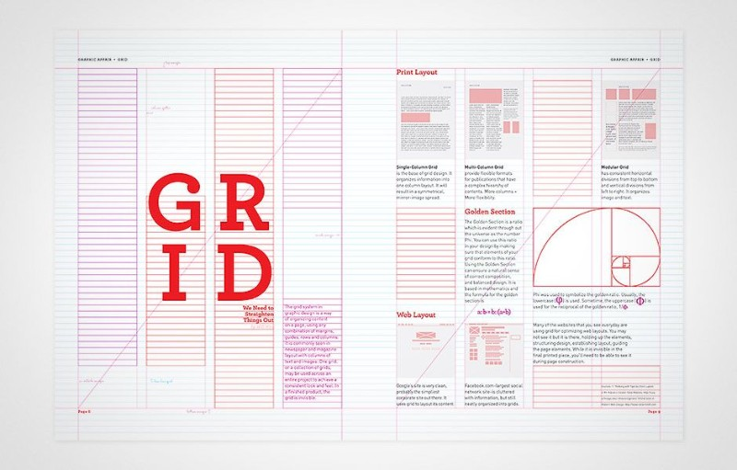
Grids

Slide 63
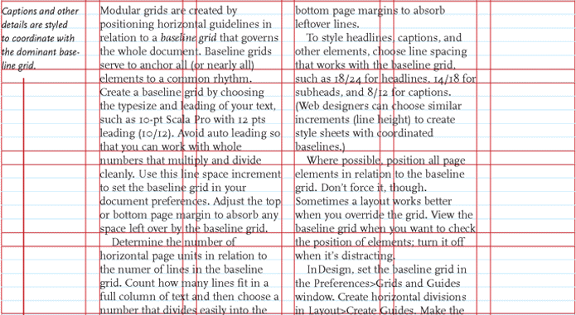
Grids

Slide 64
The Rule of Thirds

Slide 65

The Rule of Thirds

Slide 66
The Rule of Thirds

Slide 67
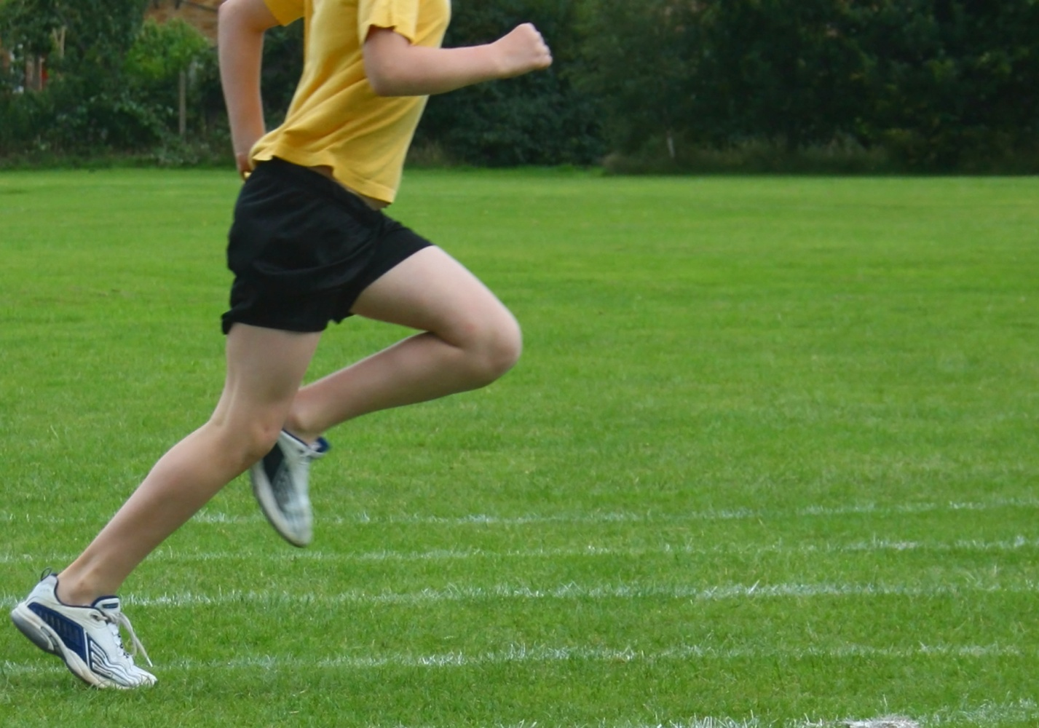
The Rule of Thirds

Slide 68
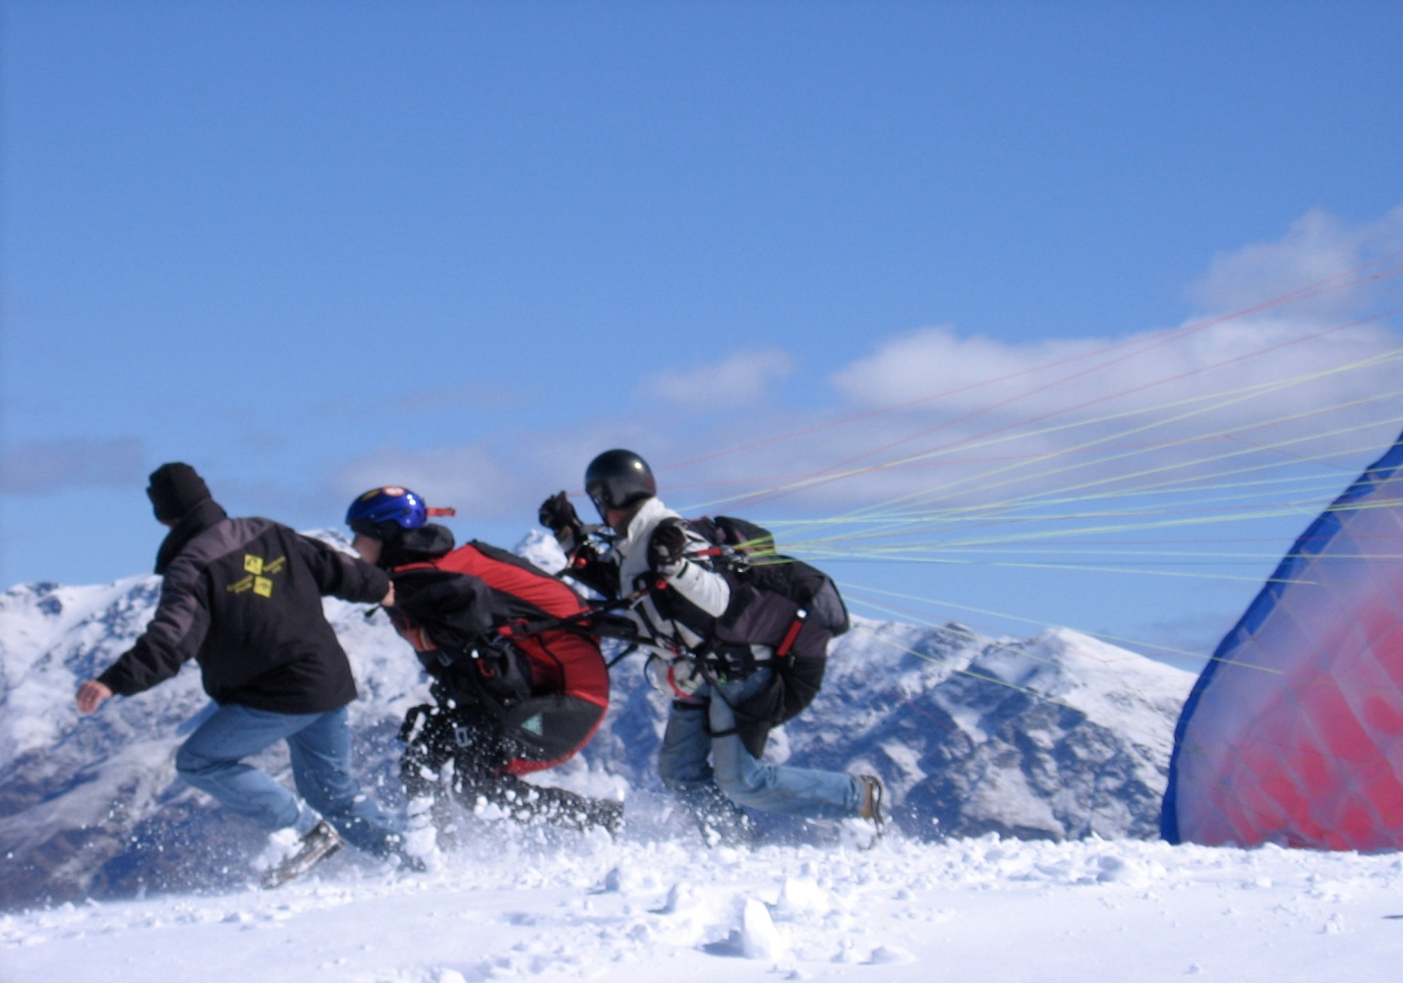
The Rule of Thirds

Slide 69
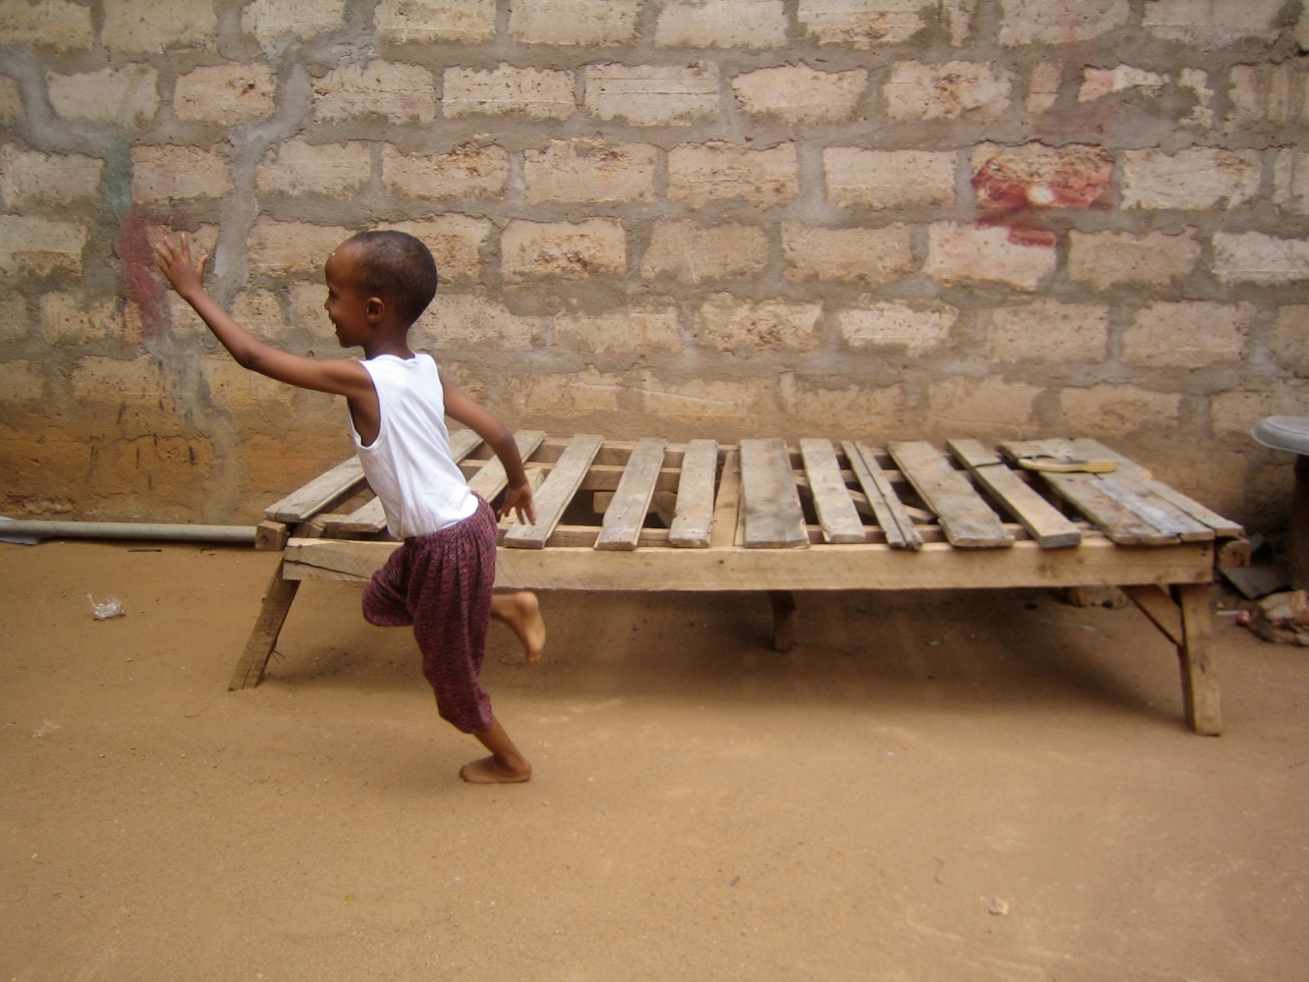
The Rule of Thirds

Slide 70

The Rule of Thirds

Slide 71

The center is more static

Slide 72

Is This Aligned?
https://medium.com/@lukejones/optical-adjustment-b55492a1165c
Notes:
Parece, mas não está!

Slide 73
Optical Alignment

Slide 74
Optical Alignment
Notes:
À direita, o perfeitamente alinhado… PARECE DESALINHADO! Temos que compensar

Slide 75

Optical Alignment

Slide 76

Optical Alignment

Slide 77
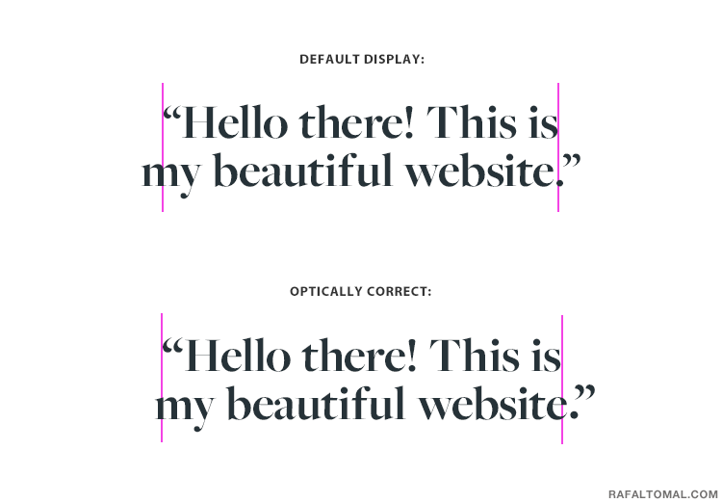
Optical Alignment – Beware quotes

Slide 78
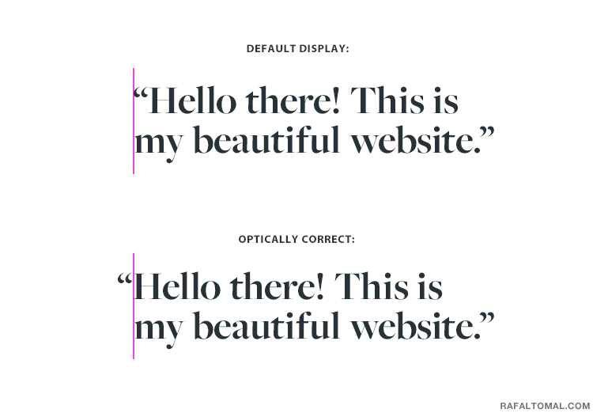
Hanging Quotes

Slide 79
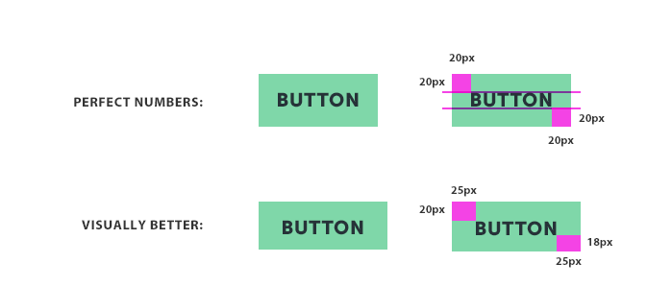
Vertical Distance Perception

Slide 80
Alignment – Summary
We must align elements
To the margins
To each other
Prefer strong alignments
Deadly Sin: miss it by a little bit!
Use grids!

Slide 81
Repetition Repetition Repetition Repetition
03

Slide 82
Repetition
Reinforces overall look
Unifies elements
Increases consistency

Slide 83
Graphic Elements
Oculista da Esquina
Os seus óculos por apenas €10000!
Visite-nos já!
Rua da Esquina, 2
1000 Lisboa

Slide 84
Graphic Elements
Oculista da Esquina
Os seus óculos por apenas €10000!
Visite-nos já!
Rua da Esquina, 2
1000 Lisboa

Slide 85

Repetition
O Grande Tema
The quick brown fox jumped over the lazy dog. The quick brown fox jumped over the lazy dog. The quick brown fox jumped over the lazy dog. The quick brown fox jumped over the lazy dog.
É importante…
The quick brown fox jumped over the lazy dog. The quick brown fox jumped over the lazy dog. The quick brown fox jumped over the lazy dog. The quick brown fox jumped over the lazy dog. The quick brown fox jumped over the lazy dog. The quick brown fox jumped over the lazy dog.
The quick brown fox jumped over the lazy dog. The quick brown fox jumped over the lazy dog. The quick brown fox jumped over the lazy dog. The quick brown fox jumped over the lazy dog. The quick brown fox jumped over the lazy. The quick brown fox jumped over the lazy dog. The quick brown fox
Outra Secção
The quick brown fox jumped over the lazy dog. The quick brown fox jumped over the lazy dog. The quick brown fox jumped over the lazy dog. The quick brown fox jumped over the lazy dog. The quick brown fox jumped over the lazy dog. The quick brown fox jumped over the lazy dog. That goes away without
The quick brown fox jumped over the lazy dog. The quick brown fox jumped over the lazy dog. The quick brown fox jumped over the lazy dog. The quick brown fox jumped over the lazy dog. The quick brown fox jumped over the lazy dog.
The quick brown fox jumped over the lazy dog. The quick brown fox jumped over the lazy dog. The quick brown fox jumped over the lazy dog. The quick brown fox jumped over the lazy dog. The quick brown fox jumped over the lazy dog. The quick brown fox jumped over the lazy dog. The quick brown fox jumped over the lazy dog.
Concluindo
The quick brown fox jumped over the lazy dog. The quick brown fox jumped over the lazy dog. The quick brown fox jumped over the lazy dog. The quick brown fox jumped over the lazy dog.
23

Slide 86
Repetition
Line Thickness
O Grande Tema
The quick brown fox jumped over the lazy dog. The quick brown fox jumped over the lazy dog. The quick brown fox jumped over the lazy dog. The quick brown fox jumped over the lazy dog.
É importante…
The quick brown fox jumped over the lazy dog. The quick brown fox jumped over the lazy dog. The quick brown fox jumped over the lazy dog. The quick brown fox jumped over the lazy dog. The quick brown fox jumped over the lazy dog. The quick brown fox jumped over the lazy dog.
The quick brown fox jumped over the lazy dog. The quick brown fox jumped over the lazy dog. The quick brown fox jumped over the lazy dog. The quick brown fox jumped over the lazy dog. The quick brown fox jumped over the lazy. The quick brown fox jumped over the lazy dog. The quick brown fox
Outra Secção
The quick brown fox jumped over the lazy dog. The quick brown fox jumped over the lazy dog. The quick brown fox jumped over the lazy dog. The quick brown fox jumped over the lazy dog. The quick brown fox jumped over the lazy dog. The quick brown fox jumped over the lazy dog. That goes away without
The quick brown fox jumped over the lazy dog. The quick brown fox jumped over the lazy dog. The quick brown fox jumped over the lazy dog. The quick brown fox jumped over the lazy dog. The quick brown fox jumped over the lazy dog.
The quick brown fox jumped over the lazy dog. The quick brown fox jumped over the lazy dog. The quick brown fox jumped over the lazy dog. The quick brown fox jumped over the lazy dog. The quick brown fox jumped over the lazy dog. The quick brown fox jumped over the lazy dog. The quick brown fox jumped over the lazy dog.
Concluindo
The quick brown fox jumped over the lazy dog. The quick brown fox jumped over the lazy dog. The quick brown fox jumped over the lazy dog. The quick brown fox jumped over the lazy dog.
23

Slide 87
Repetition
Line Thickness
O Grande Tema
The quick brown fox jumped over the lazy dog. The quick brown fox jumped over the lazy dog. The quick brown fox jumped over the lazy dog. The quick brown fox jumped over the lazy dog.
É importante…
The quick brown fox jumped over the lazy dog. The quick brown fox jumped over the lazy dog. The quick brown fox jumped over the lazy dog. The quick brown fox jumped over the lazy dog. The quick brown fox jumped over the lazy dog. The quick brown fox jumped over the lazy dog.
The quick brown fox jumped over the lazy dog. The quick brown fox jumped over the lazy dog. The quick brown fox jumped over the lazy dog. The quick brown fox jumped over the lazy dog. The quick brown fox jumped over the lazy. The quick brown fox jumped over the lazy dog. The quick brown fox
Outra Secção
The quick brown fox jumped over the lazy dog. The quick brown fox jumped over the lazy dog. The quick brown fox jumped over the lazy dog. The quick brown fox jumped over the lazy dog. The quick brown fox jumped over the lazy dog. The quick brown fox jumped over the lazy dog. That goes away without
The quick brown fox jumped over the lazy dog. The quick brown fox jumped over the lazy dog. The quick brown fox jumped over the lazy dog. The quick brown fox jumped over the lazy dog. The quick brown fox jumped over the lazy dog.
The quick brown fox jumped over the lazy dog. The quick brown fox jumped over the lazy dog. The quick brown fox jumped over the lazy dog. The quick brown fox jumped over the lazy dog. The quick brown fox jumped over the lazy dog. The quick brown fox jumped over the lazy dog. The quick brown fox jumped over the lazy dog.
Concluindo
The quick brown fox jumped over the lazy dog. The quick brown fox jumped over the lazy dog. The quick brown fox jumped over the lazy dog. The quick brown fox jumped over the lazy dog.
23

Slide 88
Repetition
O Grande Tema
The quick brown fox jumped over the lazy dog. The quick brown fox jumped over the lazy dog. The quick brown fox jumped over the lazy dog. The quick brown fox jumped over the lazy dog.
É importante…
The quick brown fox jumped over the lazy dog. The quick brown fox jumped over the lazy dog. The quick brown fox jumped over the lazy dog. The quick brown fox jumped over the lazy dog. The quick brown fox jumped over the lazy dog. The quick brown fox jumped over the lazy dog.
The quick brown fox jumped over the lazy dog. The quick brown fox jumped over the lazy dog. The quick brown fox jumped over the lazy dog. The quick brown fox jumped over the lazy dog. The quick brown fox jumped over the lazy. The quick brown fox jumped over the lazy dog. The quick brown fox
Outra Secção
The quick brown fox jumped over the lazy dog. The quick brown fox jumped over the lazy dog. The quick brown fox jumped over the lazy dog. The quick brown fox jumped over the lazy dog. The quick brown fox jumped over the lazy dog. The quick brown fox jumped over the lazy dog. That goes away without
Typeface
The quick brown fox jumped over the lazy dog. The quick brown fox jumped over the lazy dog. The quick brown fox jumped over the lazy dog. The quick brown fox jumped over the lazy dog. The quick brown fox jumped over the lazy dog.
The quick brown fox jumped over the lazy dog. The quick brown fox jumped over the lazy dog. The quick brown fox jumped over the lazy dog. The quick brown fox jumped over the lazy dog. The quick brown fox jumped over the lazy dog. The quick brown fox jumped over the lazy dog. The quick brown fox jumped over the lazy dog.
Concluindo
The quick brown fox jumped over the lazy dog. The quick brown fox jumped over the lazy dog. The quick brown fox jumped over the lazy dog. The quick brown fox jumped over the lazy dog.
23

Slide 89
Repetition
O Grande Tema
The quick brown fox jumped over the lazy dog. The quick brown fox jumped over the lazy dog. The quick brown fox jumped over the lazy dog. The quick brown fox jumped over the lazy dog.
É importante…
The quick brown fox jumped over the lazy dog. The quick brown fox jumped over the lazy dog. The quick brown fox jumped over the lazy dog. The quick brown fox jumped over the lazy dog. The quick brown fox jumped over the lazy dog. The quick brown fox jumped over the lazy dog.
The quick brown fox jumped over the lazy dog. The quick brown fox jumped over the lazy dog. The quick brown fox jumped over the lazy dog. The quick brown fox jumped over the lazy dog. The quick brown fox jumped over the lazy. The quick brown fox jumped over the lazy dog. The quick brown fox
Outra Secção
The quick brown fox jumped over the lazy dog. The quick brown fox jumped over the lazy dog. The quick brown fox jumped over the lazy dog. The quick brown fox jumped over the lazy dog. The quick brown fox jumped over the lazy dog. The quick brown fox jumped over the lazy dog. That goes away without
Spacing
The quick brown fox jumped over the lazy dog. The quick brown fox jumped over the lazy dog. The quick brown fox jumped over the lazy dog. The quick brown fox jumped over the lazy dog. The quick brown fox jumped over the lazy dog.
The quick brown fox jumped over the lazy dog. The quick brown fox jumped over the lazy dog. The quick brown fox jumped over the lazy dog. The quick brown fox jumped over the lazy dog. The quick brown fox jumped over the lazy dog. The quick brown fox jumped over the lazy dog. The quick brown fox jumped over the lazy dog.
Concluindo
The quick brown fox jumped over the lazy dog. The quick brown fox jumped over the lazy dog. The quick brown fox jumped over the lazy dog. The quick brown fox jumped over the lazy dog.
23

Slide 90
Repetition
O Grande Tema
The quick brown fox jumped over the lazy dog. The quick brown fox jumped over the lazy dog. The quick brown fox jumped over the lazy dog. The quick brown fox jumped over the lazy dog.
É importante…
The quick brown fox jumped over the lazy dog. The quick brown fox jumped over the lazy dog. The quick brown fox jumped over the lazy dog. The quick brown fox jumped over the lazy dog. The quick brown fox jumped over the lazy dog. The quick brown fox jumped over the lazy dog.
The quick brown fox jumped over the lazy dog. The quick brown fox jumped over the lazy dog. The quick brown fox jumped over the lazy dog. The quick brown fox jumped over the lazy dog. The quick brown fox jumped over the lazy. The quick brown fox jumped over the lazy dog. The quick brown fox
Outra Secção
The quick brown fox jumped over the lazy dog. The quick brown fox jumped over the lazy dog. The quick brown fox jumped over the lazy dog. The quick brown fox jumped over the lazy dog. The quick brown fox jumped over the lazy dog. The quick brown fox jumped over the lazy dog. That goes away without
Spacing
The quick brown fox jumped over the lazy dog. The quick brown fox jumped over the lazy dog. The quick brown fox jumped over the lazy dog. The quick brown fox jumped over the lazy dog. The quick brown fox jumped over the lazy dog.
The quick brown fox jumped over the lazy dog. The quick brown fox jumped over the lazy dog. The quick brown fox jumped over the lazy dog. The quick brown fox jumped over the lazy dog. The quick brown fox jumped over the lazy dog. The quick brown fox jumped over the lazy dog. The quick brown fox jumped over the lazy dog.
Concluindo
The quick brown fox jumped over the lazy dog. The quick brown fox jumped over the lazy dog. The quick brown fox jumped over the lazy dog. The quick brown fox jumped over the lazy dog.
23

Slide 91
Repetition
O Grande Tema
The quick brown fox jumped over the lazy dog. The quick brown fox jumped over the lazy dog. The quick brown fox jumped over the lazy dog. The quick brown fox jumped over the lazy dog.
É importante…
The quick brown fox jumped over the lazy dog. The quick brown fox jumped over the lazy dog. The quick brown fox jumped over the lazy dog. The quick brown fox jumped over the lazy dog. The quick brown fox jumped over the lazy dog. The quick brown fox jumped over the lazy dog.
The quick brown fox jumped over the lazy dog. The quick brown fox jumped over the lazy dog. The quick brown fox jumped over the lazy dog. The quick brown fox jumped over the lazy dog. The quick brown fox jumped over the lazy. The quick brown fox jumped over the lazy dog. The quick brown fox
Outra Secção
The quick brown fox jumped over the lazy dog. The quick brown fox jumped over the lazy dog. The quick brown fox jumped over the lazy dog. The quick brown fox jumped over the lazy dog. The quick brown fox jumped over the lazy dog. The quick brown fox jumped over the lazy dog. That goes away without
The quick brown fox jumped over the lazy dog. The quick brown fox jumped over the lazy dog. The quick brown fox jumped over the lazy dog. The quick brown fox jumped over the lazy dog. The quick brown fox jumped over the lazy dog.
The quick brown fox jumped over the lazy dog. The quick brown fox jumped over the lazy dog. The quick brown fox jumped over the lazy dog. The quick brown fox jumped over the lazy dog. The quick brown fox jumped over the lazy dog. The quick brown fox jumped over the lazy dog. The quick brown fox jumped over the lazy dog.
Concluindo
The quick brown fox jumped over the lazy dog. The quick brown fox jumped over the lazy dog. The quick brown fox jumped over the lazy dog. The quick brown fox jumped over the lazy dog.
Width
23

Slide 92
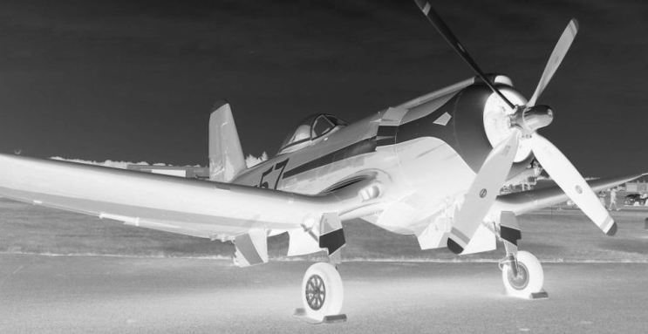
Document-wide repetition
O Grande Tema
The quick brown fox jumped over the lazy dog. The quick brown fox jumped over the lazy dog. The quick brown fox jumped over the lazy dog. The quick brown fox jumped over the lazy dog.
É importante…
The quick brown fox jumped over the lazy dog. The quick brown fox jumped over the lazy dog. The quick brown fox jumped over the lazy dog. The quick brown fox jumped over the lazy dog. The quick brown fox jumped over the lazy dog. The quick brown fox jumped over the lazy dog.
The quick brown fox jumped over the lazy dog. The quick brown fox jumped over the lazy dog. The quick brown fox jumped over the lazy dog. The quick brown fox jumped over the lazy dog. The quick brown fox jumped over the lazy. The quick brown fox jumped over the lazy dog. The quick brown fox
Outra Secção
The quick brown fox jumped over the lazy dog. The quick brown fox jumped over the lazy dog. The quick brown fox jumped over the lazy dog. The quick brown fox jumped over the lazy dog. The quick brown fox jumped over the lazy dog. The quick brown fox jumped over the lazy dog. That goes away without
The quick brown fox jumped over the lazy dog. The quick brown fox jumped over the lazy dog. The quick brown fox jumped over the lazy dog. The quick brown fox jumped over the lazy dog. The quick brown fox jumped over the lazy dog. The quick brown fox jumped over the lazy dog.
The quick brown fox jumped over the lazy dog. The quick brown fox jumped over the lazy dog. The quick brown fox jumped over the lazy dog. The quick brown
Outra Coisa
The quick brown fox jumped over the lazy dog. The quick brown fox jumped over the lazy dog. The quick brown fox jumped over the lazy dog. The quick brown fox jumped over the lazy dog. The quick brown fox jumped over the lazy dog when it is a
The quick brown fox jumped over the lazy dog. The quick brown fox jumped over the lazy dog. The quick brown fox jumped over the lazy dog. The quick brown fox jumped over the lazy dog. The quick brown fox jumped over the lazy dog.
The quick brown fox jumped over the lazy dog. The quick brown fox jumped over the lazy dog. The quick brown fox jumped over the lazy dog. The quick brown fox jumped over the lazy dog. The quick brown fox jumped over the lazy dog. The quick brown fox jumped over the lazy dog. The quick brown fox jumped over the lazy dog.
E Mais Ainda
The quick brown fox jumped over the lazy dog. The quick brown fox. The quick brown fox jumped over as
The quick brown fox jumped over the lazy dog. The quick brown fox jumped over the lazy dog. The quick brown fox jumped over the lazy dog. The quick brown fox jumped over the lazy dog. The quick brown fox jumped over the lazy dog.
The quick brown fox jumped over the lazy dog. The quick brown fox jumped over the lazy dog. The quick brown fox jumped over the lazy dog. The quick brown fox jumped over the lazy dog. The quick brown fox jumped over the lazy dog. The quick brown fox jumped over the lazy dog. The quick brown fox jumped over the lazy dog.
Concluindo
The quick brown fox jumped over the lazy dog. The quick brown fox jumped over the lazy dog. The quick brown fox jumped over the lazy dog. The quick brown fox jumped over the lazy dog.
23
24

Slide 93
Contrast
04

Slide 94
Contrast
Increase Interest
Reduce boredom

Slide 95
Contrast
If it contrasts let it do so
A LOT

Slide 96

Contrast
Primeira Festa das Flores
Gosta de Flores?
Venha visitar a primeira grande festa das flores de Rodapé de Baixo.
Sábado, 15 de Abril a Segunda 17 de Abril, Praça Central
Uma gardénia grátis aos primeiros 100 visitantes
Mais informações: Junta de Freguesia da Cunha, Tel: 991234123

Slide 97
Contrast
Primeira Festa das Flores
Gosta de Flores?
Venha visitar a primeira grande festa das flores de Rodapé de Baixo.
Sábado, 15 de Abril a Segunda 17 de Abril, Praça Central
Uma gardénia grátis aos primeiros 100 visitantes
Mais informações: Junta de Freguesia da Cunha, Tel: 991234123
Slightly larger…
Slightly smaller…

Slide 98

Contrast
Primeira Festa das Flores
Gosta de Flores?
Venha visitar a primeira grande festa das flores de Rodapé de Baixo.
Sábado, 15 de Abril a Segunda 17 de Abril,
Praça Central
Uma gardénia grátis aos primeiros 100 visitantes
Mais informações: Junta de Freguesia da Cunha, Tel: 991234123

Slide 99
Contrast
Primeira Festa das Flores
Background Color
Gosta de Flores?
Venha visitar a primeira grande festa das flores de Rodapé de Baixo.
Sábado, 15 de Abril a Segunda 17 de Abril,
Praça Central
Uma gardénia grátis aos primeiros 100 visitantes
Mais informações: Junta de Freguesia da Cunha, Tel: 991234123

Slide 100
Contrast
Primeira Festa das Flores
Typeface
Gosta de Flores?
Venha visitar a primeira grande festa das flores de Rodapé de Baixo.
Sábado, 15 de Abril a Segunda 17 de Abril,
Praça Central
Uma gardénia grátis aos primeiros 100 visitantes
Mais informações: Junta de Freguesia da Cunha, Tel: 991234123

Slide 101
Contrast
Primeira Festa das Flores
Gosta de Flores?
Venha visitar a primeira grande festa das flores de Rodapé de Baixo.
Sábado, 15 de Abril a Segunda 17 de Abril,
Praça Central
Uma gardénia grátis aos primeiros 100 visitantes
Font size
Mais informações: Junta de Freguesia da Cunha, Tel: 991234123

Slide 102
Contrast
Primeira Festa das Flores
Gosta de Flores?
Venha visitar a primeira grande festa das flores de Rodapé de Baixo.
Sábado, 15 de Abril a Segunda 17 de Abril,
Praça Central
Uma gardénia grátis aos primeiros 100 visitantes
Spacing
Mais informações: Junta de Freguesia da Cunha, Tel: 991234123

Slide 103

Contrast
Notes:
Font sizes!

Slide 104

Contrast
Notes:
Font sizes!

Slide 105

Contrast

Slide 106
Whitespace
05

Slide 107
Whitespace
Not all the space needs to be occupied...

Slide 108
Whitespace
“What a waste of space... You could have fit in that other table...”

Slide 109

Whitespace
Notes:
A nossa reacção à frase anterior... Não é preciso sobrecarregar tudo!

Slide 110
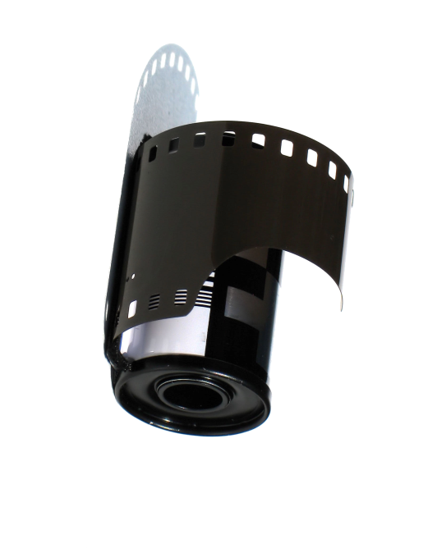
Whitespace
Avoid “trapped” space
Produção de
Conteúdos
Multimédia

Slide 111
Whitespace
Avoid “trapped” space
Produção de
Conteúdos
Multimédia

Slide 112

Whitespace
Avoid “trapped” space
Produção de
Conteúdos
Multimédia

Slide 113

Trapped Whitespace
http://simplicitybylateblossom.blogspot.com/2013/01/trapped-white-space-defined.html

Slide 114

Trapped Whitespace
http://simplicitybylateblossom.blogspot.com/2013/01/trapped-white-space-defined.html

Slide 115

Trapped Whitespace
http://simplicitybylateblossom.blogspot.com/2013/01/trapped-white-space-defined.html

Slide 116

Trapped Whitespace
http://simplicitybylateblossom.blogspot.com/2013/01/trapped-white-space-defined.html

Slide 117

Trapped Whitespace
http://simplicitybylateblossom.blogspot.com/2013/01/trapped-white-space-defined.html

Slide 118

Trapped Whitespace
http://simplicitybylateblossom.blogspot.com/2013/01/trapped-white-space-defined.html

Slide 119

Negative Space

Slide 120

Negative Space

Slide 121

Negative Space

Slide 122

Negative Space

Slide 123
Typography
06

Slide 124

It all began here...
Gutenberg, 1439

Slide 125
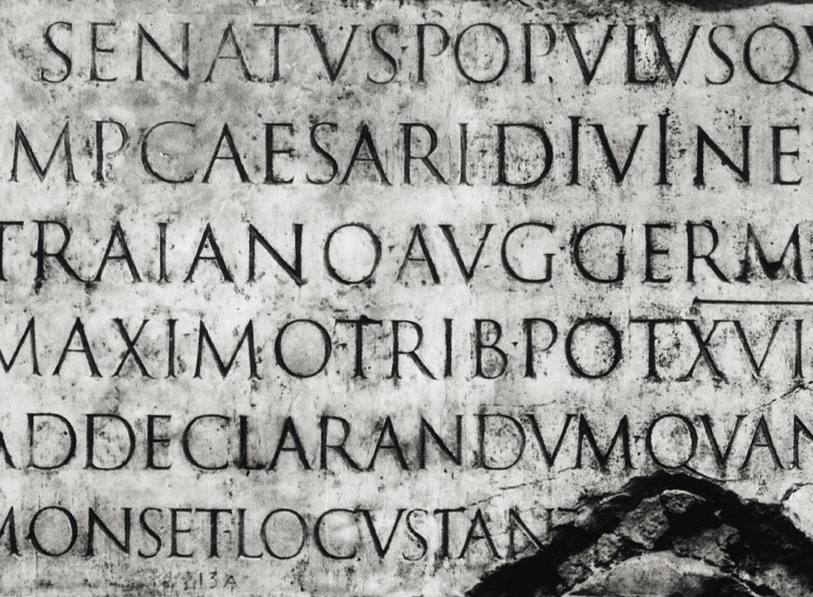
Roman Type...
Notes:
Os primeiros tipos de texto foram criados com base nos textos em documentos romanos (na figura, a coluna de Trajano, em Roma, 113AD). A primeira edição completa desse tipo foi criada por Jenson, um Francês, em 1460

Slide 126
When do you think they appeared?
Garamond
Bodoni
Times New Roman
Notes:
Q&A

Slide 127
When do you think they appeared?
Garamond
XVI
Bodoni
Times New Roman

Slide 128
When do you think they appeared?
Garamond
XVI
Bodoni
XVIII
Times New Roman

Slide 129
When do you think they appeared?
Garamond
XVI
Bodoni
XVIII
Times New Roman
XX
Notes:
A palavra Garamond refere-se aos tipos originais baseados na tipografia de Claude Garamond ca, 1530.
A Bodoni foi criada por Giambattista Bodoni, considerado um dos maiores tipógrafo do Século XVIII.
Times foi encomendada pelo jornal do mesmo nome

Slide 130
Font Groups
Oldstyle
“Venetian” (Jenson, ~1460)
Garamond (Garamond, ~1540)
Caslon (Caslon, ~1730)
Times New Roman (Morison & Ardent, 1931; Transitional)
Slanted serifs & Diagonal Stress
Thick / thin transitions are smooth
Notes:
http://www.scrapbookgraphics.com/vBulletin/showthread.php?5743-Let-s-Talk-Type-Part-1-Font-Families

Slide 131

Font Groups
Old Style Examples

Slide 132
Font Groups
Modern
Didot (Didot family, ~1790)
Bodoni (Bodoni, ~1798)
Horizontal serifs
Thick / thin transitions are abrupt
Notes:
Didot is a name given to a group of typefaces named after the famous French printing and type producing family. The classification is known as modern, or Didone. The typeface we know today was based on a collection of related types developed in the period 1784–1811. Firmin Didot (1764–1836) cut the letters, and cast them as type in Paris. His brother, Pierre Didot (1760–1853) used the types in printing

Slide 133
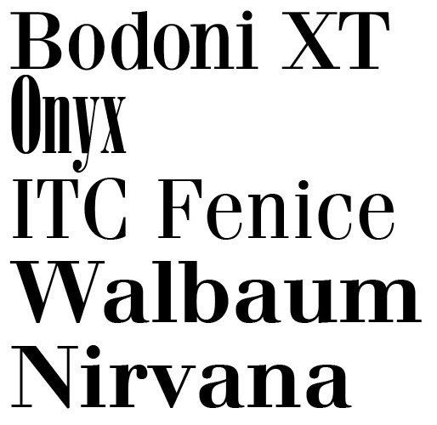
Modern Fonts

Slide 134
Font Groups
Slab Serif
Egyptienne (Clarendon family, ~1800)
Egyptienne (Clarendon, ~1799)
Thick Slab/like serifs
Main Families
Egyptienne
Neogrotestque
Italienne
Typewriter
Notes:
Following Napoleon's Egyptian campaign and dissemination of images and descriptions via publications like Description de l'Égypte (1809) an intense cultural fascination with all things Egyptian followed. Suites of contemporary parlor furniture were produced resembling furniture found in tombs. Multicolored woodblock printed wallpaper could make a dining room in Edinburgh or Chicago feel like Luxor. While there was no relationship between Egyptian writing systems and slab serif types, either shrewd marketing or honest confusion led to slab serifs often being called Egyptians, and many early ones are named for the subject: Cairo, Karnak, and Memphis. The common metonym "Egyptian" is derived from a craze for Egyptian artifacts in Europe and North America in the early nineteenth century, which led typefounders producing Slab Serifs after Figgins' work to call their designs Egyptian.^{[2]} However, the term Egyptian had previously been used to describe sans-serif types in England, so the term 'Antique' was used by British and American typefounders. The term Egyptian was adopted by French and German foundries, where it became Egyptienne.

Slide 135


Slab Serif

Slide 136
Font Groups
Sans Serif
Caslon (Caslon, 1816)
Gill Sans (Eric Gill, 1926)
Futura (Paul Renner, 1927)
Helvetica (Max Miedinger, 1957)
No serifs (*)
Uniform width
Notes:
This isn't entirely true, because there are some exceptions. For example, "g" and "a". In some fonts

Slide 137

Sans Serif

Slide 138
Font Groups
Script
Emulate handwritten characters
Notes:
MORTE A MS COMIC SANS
Fonts for children should not be adult business

Slide 139

Script

Slide 140
Font Groups
Ornamental
For specific uses…

Slide 141

Ornamental

Slide 142
Font Groups
When combining different sizes, make sure they are really different!
Produção de Conteúdos Multimedia
EXCELENTE!

Slide 143
Several Font Groups
Do not use two fonts of the same kind at once
PCM
A Excelente Disciplina do Técnico!
PCM
A Excelente Disciplina do Técnico!

Slide 144
Weight
Contrast different weights
Gill Sans MT Extra Condensed
Gill Sans MT Condensed
Gill Sans MT
Gill Sans MT Bold
Gill Sans MT Ultra Bold Condensed
Gill Sans MT Ultra Bold

Slide 145
Reduced number of fonts
Do not use more than two or three fonts in each document.
Confusing and unaesthetic

Slide 146
Using Text
Take output medium into consideration
Screen / projector have low resolution
Use Sans Serif fonts
On Paper:
Serifs create a natural line, making reading easier

Slide 147
Using Text
Avoid WRITING EVERYTHING IN CAPITALS, ESPECIALLY IN LARGE TEXT BLOCKS LIKE THIS ONE, BECAUSE THEY BECOME HARD TO READ…
EXPERIMENT
experiment

Slide 148
Fonts have meaning…
It is with regret we must inform that your dear uncle Steve has passed away last evening. The funeral arrangements have been made for this afternoon at 5p.m. We will be picking you up at the train station.
Notes:
This doesn’t look good. The font is playful, the message is serious
Actually, Comic Sans should be used… NEVER!!!!! (unless it is in a speech balloon for a comic)

Slide 149
Fonts have meaning…
It is with regret we must inform that your dear uncle Steve has passed away last evening. The funeral arrangements have been made for this afternoon at 5p.m. We will be picking you up at the train station.
Notes:
Nope. Still doesn’t work…

Slide 150
Fonts have meaning…
It is with regret we must inform that your dear uncle Steve has passed away last evening. The funeral arrangements have been made for this afternoon at 5p.m. We will be picking you up at the train station.
Notes:
More or less ok

Slide 151
Fonts have meaning…
Kick back & relax
KICKBACK
ANDRELAX

Slide 152
Color
07

Slide 153
Color
We already discussed color models, but...
... how to pick good color schemes?

Slide 154

Color Wheel
Use the color wheel!

Slide 155
Monochrome scheme

Slide 156
Example Slide – Monochrome
Aqui temos um texto de exemplo
E aqui outro texto ainda

Slide 157
Complementary Scheme

Slide 158
Example Slide – Complementary
Aqui temos um texto de exemplo
E aqui outro texto ainda

Slide 159
Analogous Scheme

Slide 160
Example Slide – Analogous
Aqui temos um texto de exemplo
E aqui outro texto ainda

Slide 161
Triadic Scheme

Slide 162
Example Slide – Triadic
Aqui temos um texto de exemplo
E aqui outro texto ainda

Slide 163
Tetradic Scheme

Slide 164
Example Slide – Tetradic
Aqui temos um texto de exemplo
E aqui outro texto ainda

Slide 165

Choose colors from images

Slide 166

Choose colors from images
Festa das Flores

Slide 167
Color Psychology
Colors have meanings
Cultural associations
Purity, innocence, cleanliness
Heat, violence, war, stop, forbidden
Nature, health, envy, advance, allowed
Cold, depth, wisdom, trust
Heat, joy / Jealousy, sickness
Royalty, mystery, romance, nostalgia

Slide 168

The Psychology of Logos

Slide 169
Color – Summary
Color is the hardest element to master
From theory to practice…
Creativity
Experiment!
Experiment!
Experiment!

Slide 170
Color – References
Adobe Color
http://color.adobe.com/
Color Theory in Action
http://www.color-wheel-pro.com/color-meaning.html
Color Calculator
https://www.sessions.edu/color-calculator/
Color Scheme Designer
http://colorschemedesigner.com/
Learning to Use Color on Your Web Site
http://www.creativepro.com/story/feature/6858.html
The Psychology of Color
https://www.helpscout.net/blog/psychology-of-color/

Slide 171
Examples
08

Slide 172
Example – Report
Produção de Conteúdos Multimédia
Ferramenta de Pós-Produção de Vídeo
Daniel Gonçalves
Março de 2007
Instituto Superior Técnico

Slide 173
Report – Proximity
Produção de Conteúdos Multimédia
Ferramenta de Pós-Produção de Vídeo
Daniel Gonçalves
Março de 2007
Instituto Superior Técnico

Slide 174
Report – Contrast (I)
Produção de Conteúdos Multimédia
Daniel Gonçalves
Março de 2007
Instituto Superior Técnico
Ferramenta de Pós-Produção de Vídeo

Slide 175
Report – Typography + Contrast
Produção de Conteúdos Multimédia
Daniel Gonçalves
Março de 2007
Instituto Superior Técnico
Ferramenta de Pós-Produção de Vídeo

Slide 176
Report – Alignment
Produção de Conteúdos Multimédia
Daniel Gonçalves
Março de 2007
Instituto Superior Técnico
Ferramenta de Pós-Produção de Vídeo

Slide 177
Report – (More) Repetition
Produção de Conteúdos Multimédia
Daniel Gonçalves
Março de 2007
Instituto Superior Técnico
Ferramenta de Pós-Produção de Vídeo

Slide 178
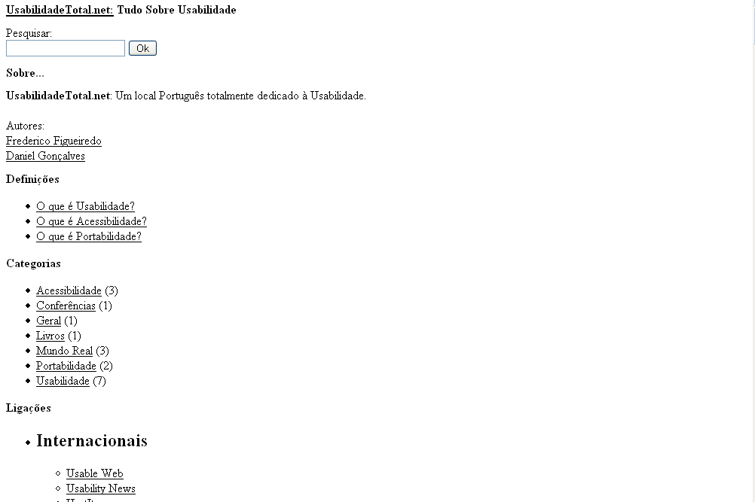
Example – Web Page

Slide 179
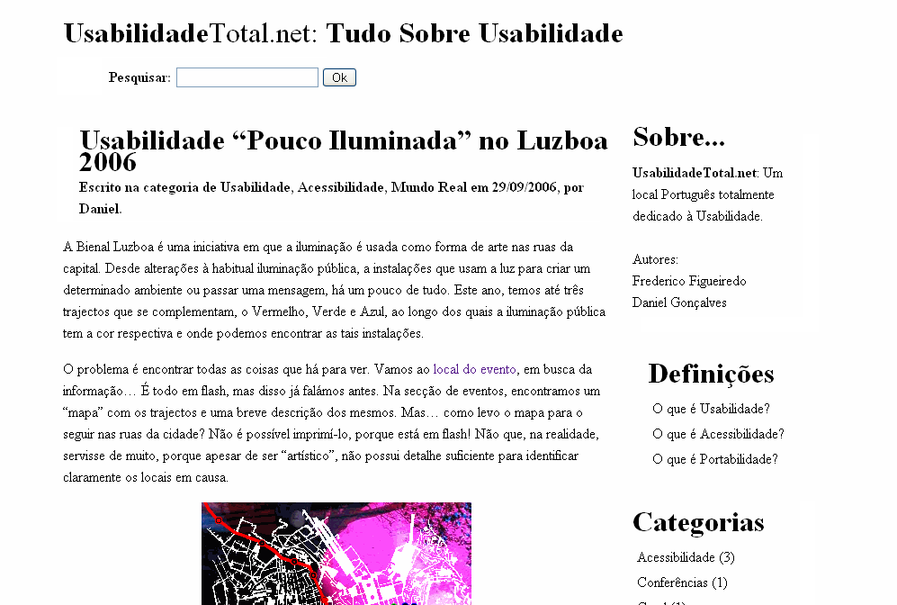
Web Page – Proximity + Contrast

Slide 180
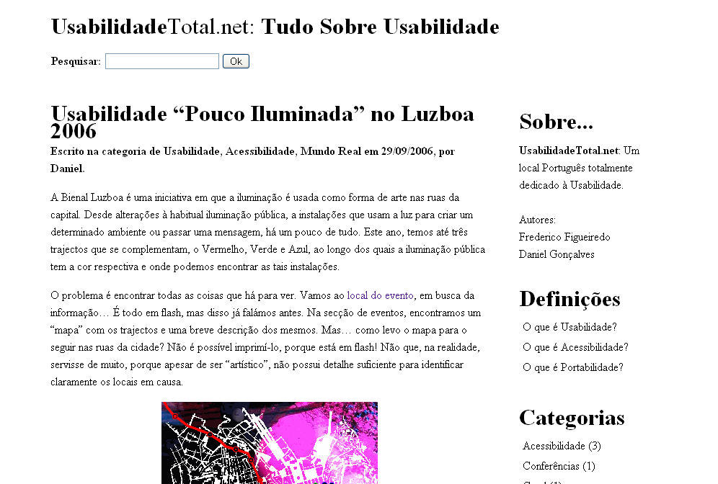
Web Page – Alignment

Slide 181
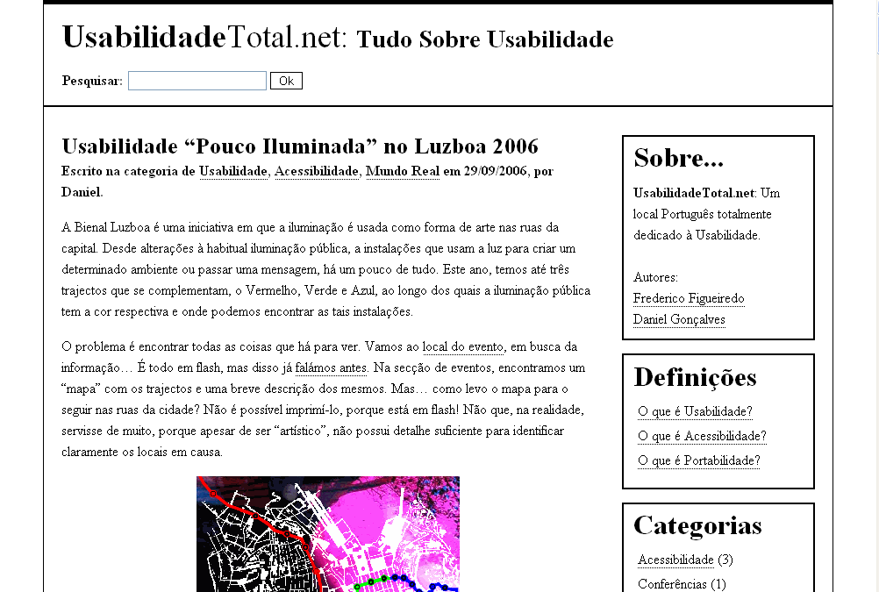
Web Page – Repetition

Slide 182
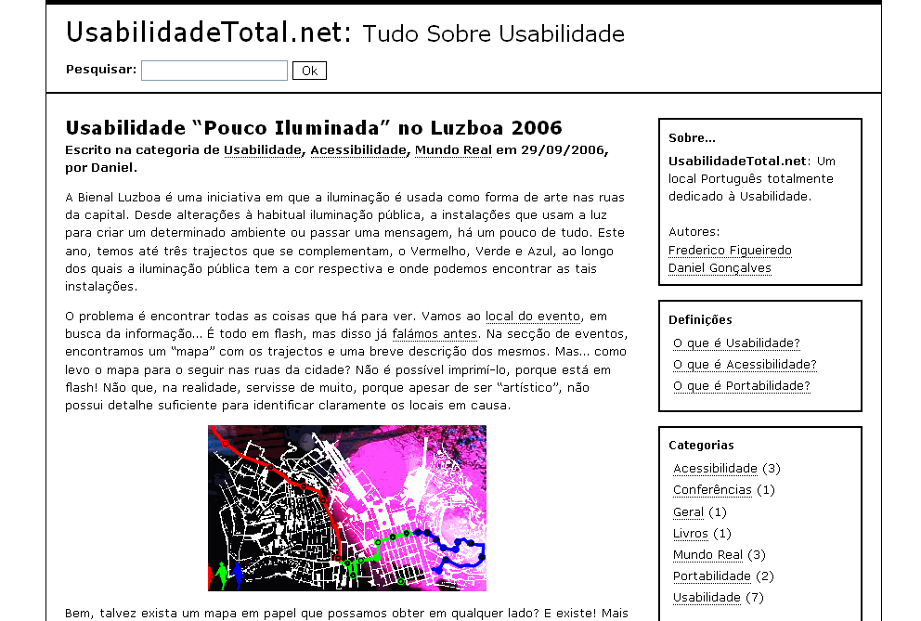
Web Page – Typography

Slide 183

Web Page – Color

Slide 184

To know more…
The Non-Designer’s Design Book, 3rdEd.
Robin Williams, Peachpit Press, 2008

Slide 185

To Know More
Design Basics Index
Jim Krause, David & Charles Ed., 2004

Slide 186
And also…
Presentations
Illustrations and Videos
Element Positioning
Superimposed information
Colors
Opening sequences, separators

